Slide 1



CNP25: CHIKV-Nsp3-MD (LDS hits/ Fragments)
Hadia Almahli
12th Dec 2024
Notes:
The macrodomain of nsP3 (nsP3MD) is highly conserved among the alphaviruses and ADP-ribosylhydrolase activity of Chikungunya Virus (CHIKV) nsP3MD is critical for CHIKV viral replication and virulence. No small molecule drugs targeting CHIKV nsP3 have been identified to date. Here we report small fragments that bind to nsP3MD which were discovered by virtually screening a fragment library and X-ray crystallography. These identified fragments share a similar scaffold, 2-pyrimidone-4-carboxylic acid, and are specifically bound to the ADP-ribose binding site of nsP3MD. Among the fragments, 2-oxo-5,6-benzopyrimidine-4-carboxylic acid showed anti-CHIKV activity with an IC₅₀ of 23 μM. Our fragment-based drug discovery approach provides valuable information to further develop a specific and potent nsP3 inhibitor of CHIKV viral replication based on the 2-pyrimidone-4-carboxylic acid scaffold. In silico studies suggest this pyrimidone scaffold could also bind to the macrodomains of other alphaviruses and coronaviruses and thus, have potential pan-antiviral activity.

Slide 2

Synthesis of SAR expansion
c2370a - Z9101663888
RA-0188454-02
3 compounds from Hadia and 4 compounds from Ed
Shipped on 23rd Nov 2024 to Jasmin and Wenjie
11 amines
Shipped on 23 Nov 2024 for CAR
Partially soluble in DCM, CH3CN
Small scale reaction

Slide 3
Remaining in the flask
HA-006-07-01:
1-Old bottle of DIPEA
2-Seives added
3-New DIPEA added
4- White precipitate was formed.
5- Filtration/ white solid was washed by Petrol ether and left to dry overnight- insoluble in D2O, DMSO.
7- White solid (HA-006-07-01)- remaining traces of the white solid in the reaction flask were taken for NMR-
was soluble in DMSO (sent for testing)
HA-006-10-01:
1- insoluble SM (HA-006-07-01) in aq.KOH, MeOH at Reflux
2- Filtration after overnight reaction to get the white solid (SM).
3- The filtrate was concentrated and LCMS showed the presence of the product/ sent for testing.

Slide 4

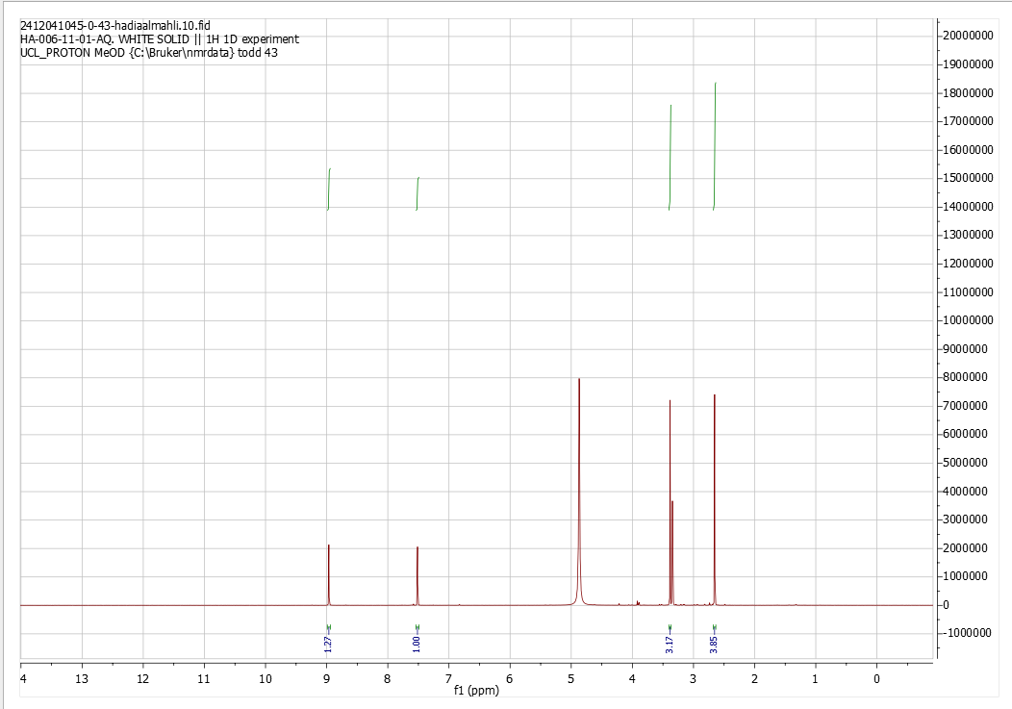
Amide coupling
29 amines
CAR
Work up: Ph=7 then acidic
One reaction was successful-Matthew Golding
Purity > 98%

Slide 5
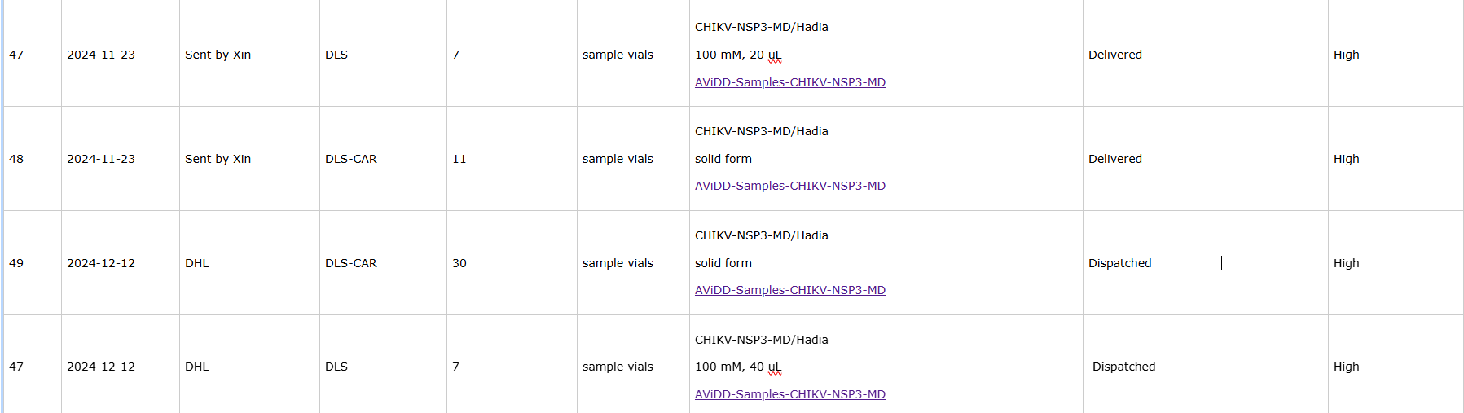
Shipment process
Work up: Ph=7 then acidic
2nd shipment for X-ray and biophysical essays on 12th Dec 2024:
6 synthetic compounds(Hadia) and 2 compounds (ED)= 8 synthetic compounds
Duplicate trays (Jasmin and Wenjie)
Compounds registration
Plate map
DMSO stock preparation/ calculated concentration
Shipment in dry ice.
For CAR:
29 labelled samples preparation
1 carboxylic acid
Plate map
Shipment to DLS team/ Xin

Slide 6
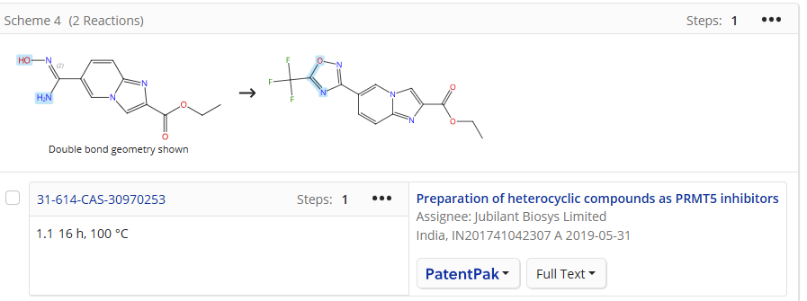
Synthesis of expansion for SAR
2nd rated compound
c2344a - Z1848859154
What’s next?
RA-0188499-02
Planned expansion
Purchased reactants
A fast and efficient one-pot microwave assisted synthesis of variously di-substituted 1,2,4-oxadiazoles
https://doi.org/10.1039/C1OB06055D
Notes:
Patent:
Preparation of heterocyclic compounds as PRMT5 inhibitors
Assignee: Jubilant Biosys Limited
India, IN201741042307 A 2019-05-31
Or mix the reagent with the SM only ( without any coupling agent or base) in a solvent a16 h, 100 °C for 16 h
N-(3-(3,4-dihydroisoquinolin-2(1H)-yl)-2-hydroxypropyl)-6 (trifluoromethyl)imidazo[1,2-a]pyridine-2-carboxamide (Example 1) CF 3 0 K ~ O> H OH rh HH N N NH2 + HO N N N N CF 3 0 11 1-102 Example 1 [000249] To a solution of carboxylic acid (1-102, 0.2 g, 0.86 mmol) in DMF (8 mL) was added DIPEA (0.45 mL, 2.60 mmol) followed by EDC.HC (0.333 g, 1.73 mmol) and HOBt (0.266 g, 1.73 mmol). The reaction mixture was stirred for 1 h followed by addition of 1-amino-3-(3,4-dihydroisoquinolin-2(1H)-yl)propan-2-ol (I1, 0.179 g, 0.86 mmol). The reaction mixture was stirred for 16 h. The reaction was monitored till the completion of starting materials (LC/MS) and then concentrated under reduced pressure.

Slide 7
Synthesis of expansion for SAR (reactants already ordered)
3rd rated compound
RA-0188476-02
c2343a - Z9102455695
Planned expansion
Purchased reactants

Slide 8




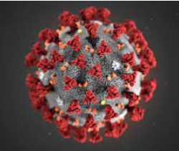
Development of new potent antivirals:
Different protein targets
Hadia Almahli
23rd Jan 2025
Notes:
Covalent warhead
Antiviral drug for SARS cov 2
Gel based data
Picogreen assay
GSH assay
One single dose response
DABCO
SARS-CoV-2 proteins can be grouped in two major classes, structural and nonstrcutural proteins (NSPs). While structural proteins, either hold the RNA genome or are built into the viral envelope, a nonstructural protein encoded by a virus is expressed in infected cells, but not incorporated into the virion particle.

Slide 9
CNP25: CHIKV-Nsp3-MD (LDS hits/ Fragments)
Notes:
The macrodomain of nsP3 (nsP3MD) is highly conserved among the alphaviruses and ADP-ribosylhydrolase activity of Chikungunya Virus (CHIKV) nsP3MD is critical for CHIKV viral replication and virulence. No small molecule drugs targeting CHIKV nsP3 have been identified to date. Here we report small fragments that bind to nsP3MD which were discovered by virtually screening a fragment library and X-ray crystallography. These identified fragments share a similar scaffold, 2-pyrimidone-4-carboxylic acid, and are specifically bound to the ADP-ribose binding site of nsP3MD. Among the fragments, 2-oxo-5,6-benzopyrimidine-4-carboxylic acid showed anti-CHIKV activity with an IC₅₀ of 23 μM. Our fragment-based drug discovery approach provides valuable information to further develop a specific and potent nsP3 inhibitor of CHIKV viral replication based on the 2-pyrimidone-4-carboxylic acid scaffold. In silico studies suggest this pyrimidone scaffold could also bind to the macrodomains of other alphaviruses and coronaviruses and thus, have potential pan-antiviral activity.

Slide 10
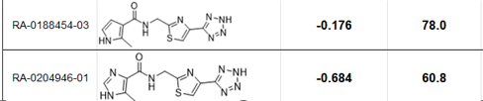
Synthesis of SAR expansion
c2370a - Z9101663888
RA-0188454-02
Amide coupling
29 amines
One reaction was successful-Matthew Golding
Crystallography: Re-soaking experiments
36 compounds to ship for testing to DLS and Wenjie: 15 Piramal + [21 ASMS compounds (11 Enamine+ 10 ChemDiv)]
Notes:
LOQ: the Limit of Quantification denotes the lowest concentration at which a sample can be reliably detected while meeting predefined criteria for bias and imprecision.
LOD: The Limit of Detection represents the lowest concentration of a sample that can be reliably distinguished from a blank and where detection is feasible

Slide 11
Synthesis of expansion for SAR
2nd rated compound
Planned expansion
c2344a - Z1848859154
RA-0188499-02
What’s next?
Purchased reactants
Preparation of heterocyclic compounds as PRMT5 inhibitors
Assignee: Jubilant Biosys Limited
India, IN201741042307 A 2019-05-31
HBTU, DIPEA, DMF, Rt
CDMT, NMM, Toluene, MW (5 min), 160 °C
A fast and efficient one-pot microwave assisted synthesis of variously di-substituted 1,2,4-oxadiazoles
https://doi.org/10.1039/C1OB06055D
CDMT, NMM, 1.4 Dioxan, reflux, 3h
Chem.Lett.2013,42,722724
NaOH, DMSO, Rt, 24h
Tetrahedron, Volume 73, Issue 7, 16 February 2017, Pages 945-951
Notes:
CDMT: 2-Chloro-4,6-dimethoxy-1,3,5-triazine
NMM: N-Methylmorpholine
Patent:
Preparation of heterocyclic compounds as PRMT5 inhibitors
Assignee: Jubilant Biosys Limited
India, IN201741042307 A 2019-05-31
Or mix the reagent with the SM only ( without any coupling agent or base) in a solvent a16 h, 100 °C for 16 h
N-(3-(3,4-dihydroisoquinolin-2(1H)-yl)-2-hydroxypropyl)-6 (trifluoromethyl)imidazo[1,2-a]pyridine-2-carboxamide (Example 1) CF 3 0 K ~ O> H OH rh HH N N NH2 + HO N N N N CF 3 0 11 1-102 Example 1 [000249] To a solution of carboxylic acid (1-102, 0.2 g, 0.86 mmol) in DMF (8 mL) was added DIPEA (0.45 mL, 2.60 mmol) followed by EDC.HC (0.333 g, 1.73 mmol) and HOBt (0.266 g, 1.73 mmol). The reaction mixture was stirred for 1 h followed by addition of 1-amino-3-(3,4-dihydroisoquinolin-2(1H)-yl)propan-2-ol (I1, 0.179 g, 0.86 mmol). The reaction mixture was stirred for 16 h. The reaction was monitored till the completion of starting materials (LC/MS) and then concentrated under reduced pressure.

Slide 12
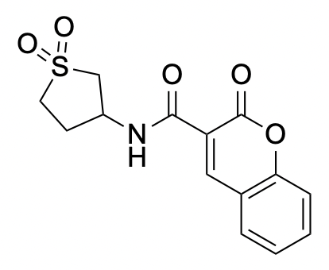
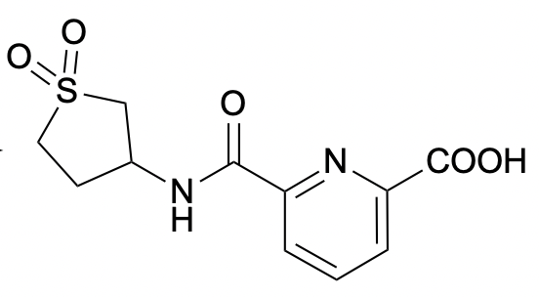
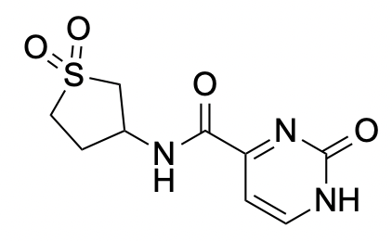
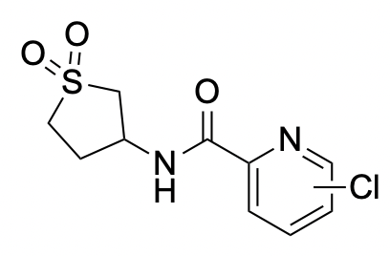
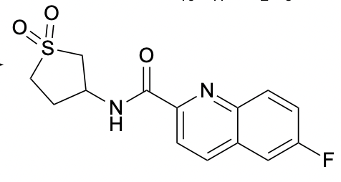
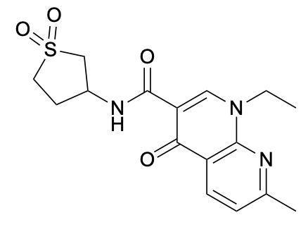
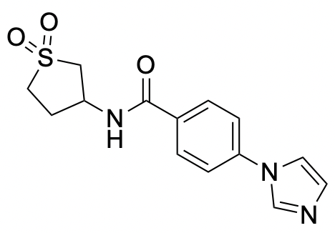
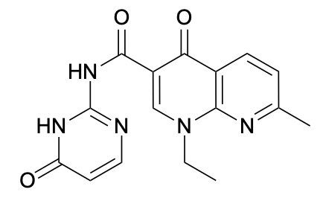
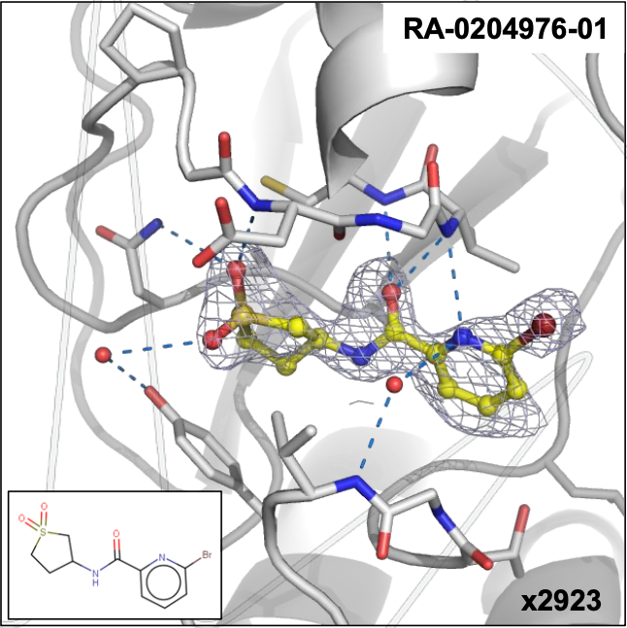
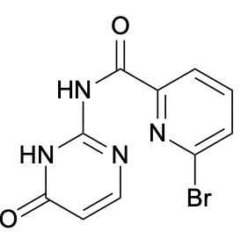
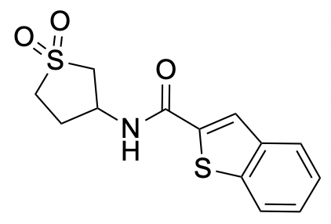
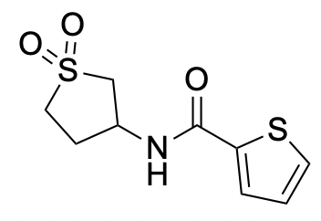
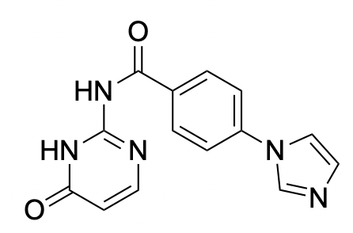
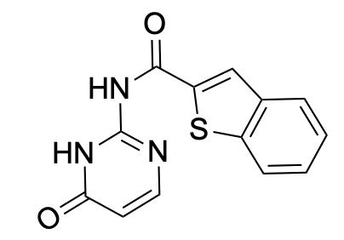
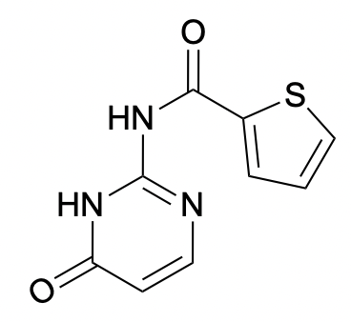
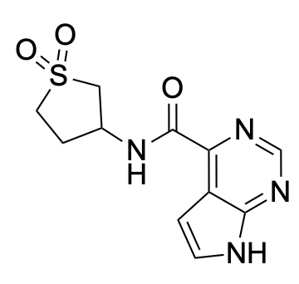
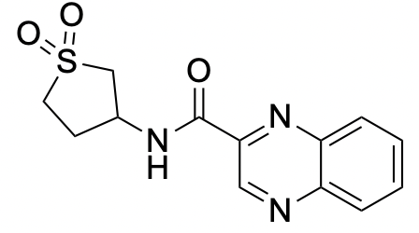
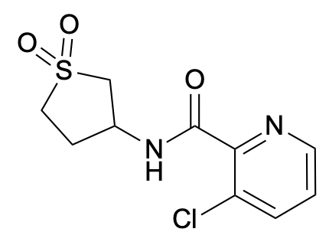
Ed’s work: CHIKV nsp3MD
Plans for next
Molecules with no soaking result
Cl at different positions for SNAR/Suzuki.
The Hit
Catalogue compounds for initial screening
Obtained, waiting for soaking

Slide 13
Overall Results:
107 amide coupling reactions: Success rate of 92% (72% initially).
76 ester amidation reactions: Success rate of 48% (18% initially, increasing to 28% after the first repetition).
49 Suzuki and SNAr reactions: Success rate of 63% (47% initially).
Buchwald-Hartwig Reactions: Success rate of 57%. A total of 336 Buchwald-Hartwig reactions were performed, targeting 42 compounds under 8 different conditions. In this run, 20 compounds were detected (48% success rate). Repeating the reactions under optimal conditions for all the 42 compounds resulted in 4 additional successes, increasing the success rate to 57%.
Compounds Overview:
134 compounds were obtained from amidation and ester amidation reactions.
31 compounds were obtained from Suzuki and SNAr reactions.
24 compounds were obtained from Buchwald-Hartwig reactions.
In total, 189 compounds are ready for soaking with CHIKV Nsp3 Macrodomain.
Click for details:
Issue#12: CAR · Issue #12 · StructuralGenomicsConsortium/CNP25-CHIKV-nsP3-Macrodomain

Slide 14


CNP27: SARS-CoV-2-NSP14 target-384 compounds (Nick Heaton’s library) HTS

Slide 15

CNP27: SARS-CoV-2-NSP14 target-384 compounds (Nick Heaton library) HTS
Shipped 26th Nov 2024 by DHL (long process)
1-Rejected entry to the US for unknown reason
2- Re-preparing another tray to ship again

Slide 16
Weak yield
Big scale
Synthetic plans
Big scale
Notes:
Alternative plan1:
1- make it in a big scale (crystallise)
2- save the hydrolysis step
piperidine-2,4-dione
1-Rearrangement reaction: 7 membered ring- do this reaction which is easier than 6 membered ring and do the alkylation, it might be more active
2- do the 6 membered ring lactam in a big scale
And prove that the R is on the lactam not on the pyrrole
which will be crystallise, you can also do this reaction starting from ,
you can alkylate it with the R you want then you make the 2nd step

Slide 17
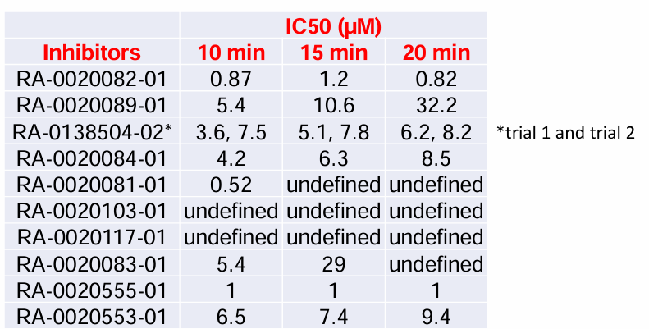
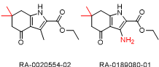
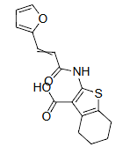
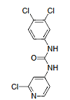
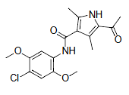
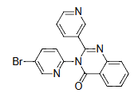
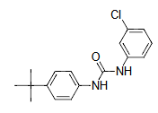
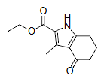
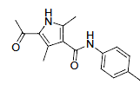
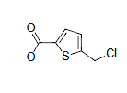
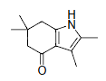
Descending Dose Response
*Table prepared by Nick and presented in the focus group meeting
Meeting with Nick on Monday
Order available analogues of RA-0020555-01
Antiviral activity in a Vero assay
Previously purchased and tested
RA-0020082-01
RA-0020555-01
RA-0138504-02
RA-0020084-01
RA-0020553-01
RA-0020089-01
RA-0020081-01
RA-0020103-01
RA-0020117-01

Slide 18
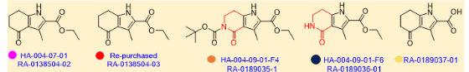
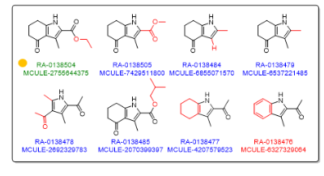
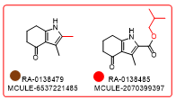
Previously purchased and shipped
RA-0020555-01
Available and cheap analogues/ Molport
Negative compounds

Slide 20
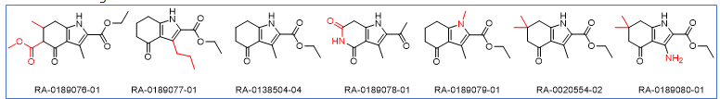
Ask Nick about the IC50 data for these compounds

Slide 21
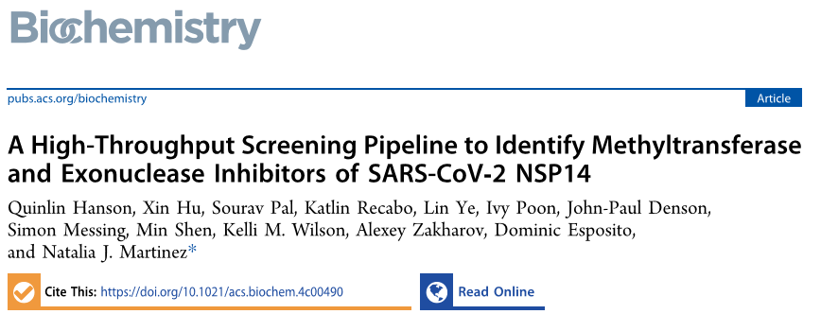
Potent NSP14 inhibitors: Positive control
Screening assay-not synthesized
Dual inhibitor
MTase and ExoN inhibitor
NSP14 ExoN inhibitor
A High-Throughput Screening Pipeline to Identify Methyltransferase and Exonuclease Inhibitors of SARS-CoV-2 NSP14
Biochemistry 2025 64 (2), 419-431
DOI: 10.1021/acs.biochem.4c00490
Notes:
A High-Throughput Screening Pipeline to Identify Methyltransferase and Exonuclease Inhibitors of SARS-CoV-2 NSP14
Quinlin Hanson, Xin Hu, Sourav Pal, Katlin Recabo, Lin Ye, Ivy Poon, John-Paul Denson, Simon Messing, Min Shen, Kelli M. Wilson, Alexey Zakharov, Dominic Esposito, and Natalia J. Martinez
Biochemistry 2025 64 (2), 419-431
DOI: 10.1021/acs.biochem.4c00490
Check

Slide 22
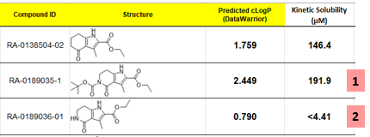
Actual solubility higher Measured solubility is greater than 75% dose concentration, actual solubility may be higher
Below LOQ
Notes:
LOQ: the Limit of Quantification denotes the lowest concentration at which a sample can be reliably detected while meeting predefined criteria for bias and imprecision.
LOD: The Limit of Detection represents the lowest concentration of a sample that can be reliably distinguished from a blank and where detection is feasible

